Slide 1
Batch Report
Irene Liu
CPSC 408

Slide 2
Current Process
BPO operators do scanning and data entry on customer invoices received through e-mail or physical mail
Documents are processed as a batch
  Grouped by customer and time frame
For SLA compliance and billing, operators have to record and verify the following information:
  Receive Time (Based off of the oldest document in the batch)
  Release Time
  Document Count

Slide 3
Workflow Diagram
Scan
Data Entry
AOS
Accounts Payable
ERP
Prep
Invoice Received

Slide 4
The Problem
Current workflow requires operators to do the following:
  Record times and counts on a physical log
  Transfer information to an excel spreadsheet
  Manually verify that the spreadsheet counts match a report generated by an Application Object Server
    Daily Totals for each customer are checked once a day
    Monthly Totals are checked at the beginning of the (next) month
Leaves room for operator error
  Functions in cells are often erased
  Operators spend more time on formatting than is necessary
  Adding more rows can be difficult
Excel does not support concurrent access
All information has to be manually reentered if spreadsheet is corrupted

Slide 5
The Solution
Web Application + Database
Support concurrent access (read/write)
All information located in one area
  No need to look at 20 different spreadsheets broken up by customer and month
Adding/Deleting records is simple
  Less time spent on column formatting
Allows for easy searching
Data is durable

Slide 6
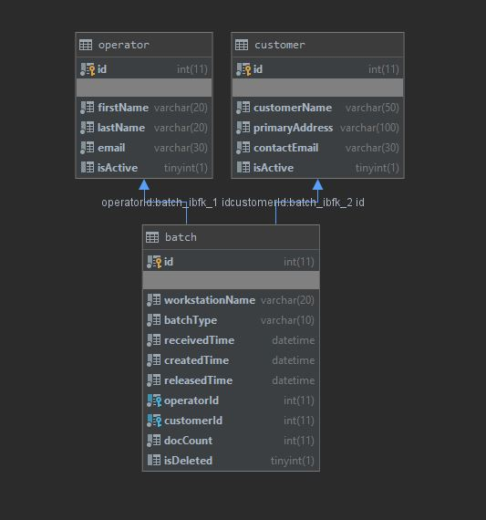
Schema

Slide 7




Demonstration

Slide 8
Planned Progress
Required
Transactions
Time reporting
  Check if receive – release is < 48 hours (excl. weekends)
Indexing
Optional
Expand the search function to query more than 1 field
Return sorted data
User Logins
Visualizations
Quick view on Home Page
Paginate the table results

